Slide 1
Business Applications
Dynamics 365 and Power Platform Fundamentals

Slide 2

Daily Rundown
Timeframe | Activity | Engagement
8:00 – 9:00 | Platform Fundamentals | Interactive Discussion
9:00 – 11:00 | Whiteboard Design Session
11:00 – 12:00 | Long Break
12:00 – 2:00 | Team Challenge | Hands On: Group Work + Presentation
2:00 – 2:15 | Wrap Up (Office Hours)
Notes:
I hope to demo as much as possible and since we only have an hour, I’ll have to go fast!
You’ll have two hours to whiteboard your solution. I’ll be available to give advice for the design. This is a time for your team to review the challenge and decide what the best plan of attack is. You can start setting up and building here if you have time. This is also a time for you to ask questions as you’re designing. After lunch, you’ll build your design and prepare your demonstration.
Each team will demo their design as if the rest of the class is your client. So try to have a few questions on hand that you think a potential client would ask. I’ll take on the role of the client as well! After demos, we’ll have time for more questions or just to stay online and connect with each other.

Slide 3
Power Platform

Slide 4
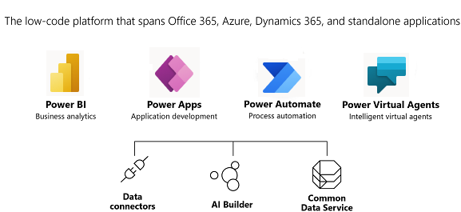

Slide 5
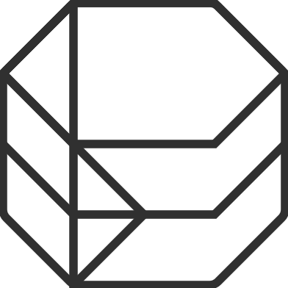
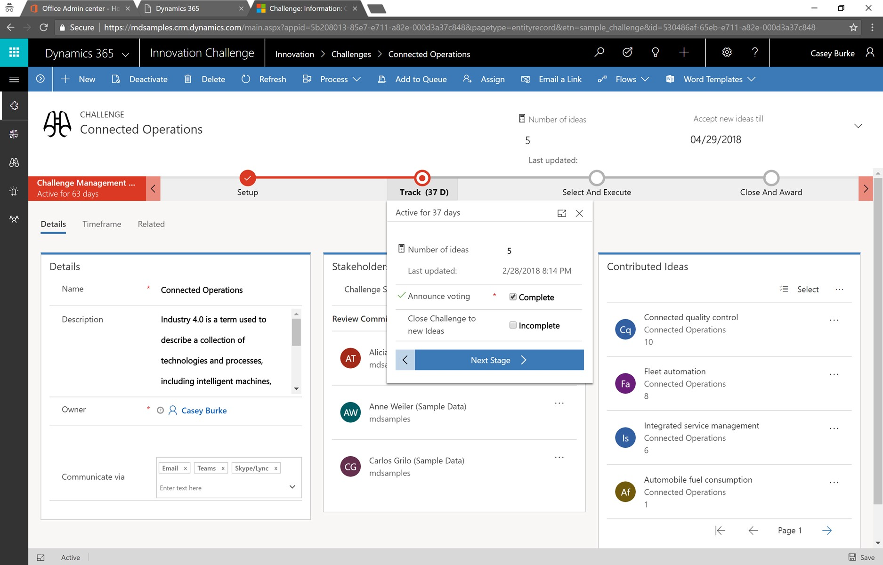
Put all your data to work with Common Data Service
Jumpstart apps using a standardized data model with business logic, security, and integration built-in
Extend to your own needs and integrate across your apps and services
Seamless Dynamics 365, Office 365, and Azure integration, augmented with data from industry partners
Notes:
Common Data Service lets you securely store and manage data that's used by business applications. Data within Common Data Service is stored within a set of entities, or a set of records used to store data. We’ll take a closer look at the CDS in today’s demo.
The CDS comes with standard entities, and each Dynamics app adds additional entities. For example, Sales has Opportunities, Lead, Goals, and Quotes while Marketing has Segments and Customer Service has Cases.
You can also create custom entities. Can you think of a situation where you might want a custom app? (ex: Property management company wants a record for each available location).
Whenever possible, I try to use the standard entities. There are a few reasons for this, other than “best practice.” One is that there are sometimes automations built into standard entities that you don’t get without having a developer create custom code. For example, in the Dynamics Sales Hub, If you have a client who says they want “Prospects” instead of “Leads,” I would rename the Lead entity. One reason is that there’s a “qualify lead” button in the sales hub that will create a contact, account, and opportunity from the Lead entity. I don’t want to have to recreate that automation when I can just repurpose the Lead entity!

Slide 6
Data connectors
Connectors are available in multiple products:
Power Automate
Power Apps
Logic Apps
Custom connectors:
An advantage of building custom connectors is that they can be used in different platforms, such as PowerApps, Power Automate, and Azure Logic Apps
It allow you to extend your app by calling a publicly available API, or a custom API you're hosting in a cloud provider, such as Azure
You can create custom connectors using three different approaches:
Using a blank custom connector
From an OpenAPI definition
From a Postman collection
Notes:
There are hundreds of connectors available. Over 325 in April of 2020!

Slide 7
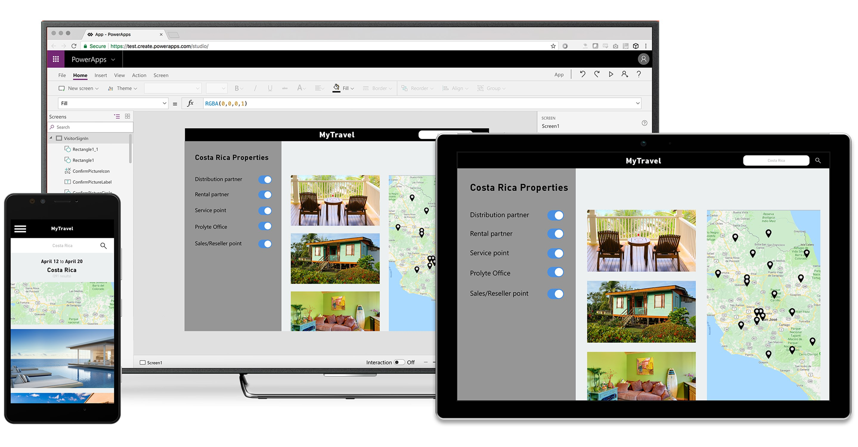
Build and consume solutions for web and mobile with Power Apps
Build highly customized task- and role-based canvas apps with data from one or multiple sources
Generate immersive model-driven apps, starting from your data model and business processes
Consume fully accessible apps across web and mobile, embedded or standalone, on any device
Notes:
This is where we’ll be spending most of our time today, so I’ll try to make sure to demo this instead of talking through it!
Building custom apps is essentially designing how your data is displayed, accessed, and updated by users.

Slide 8

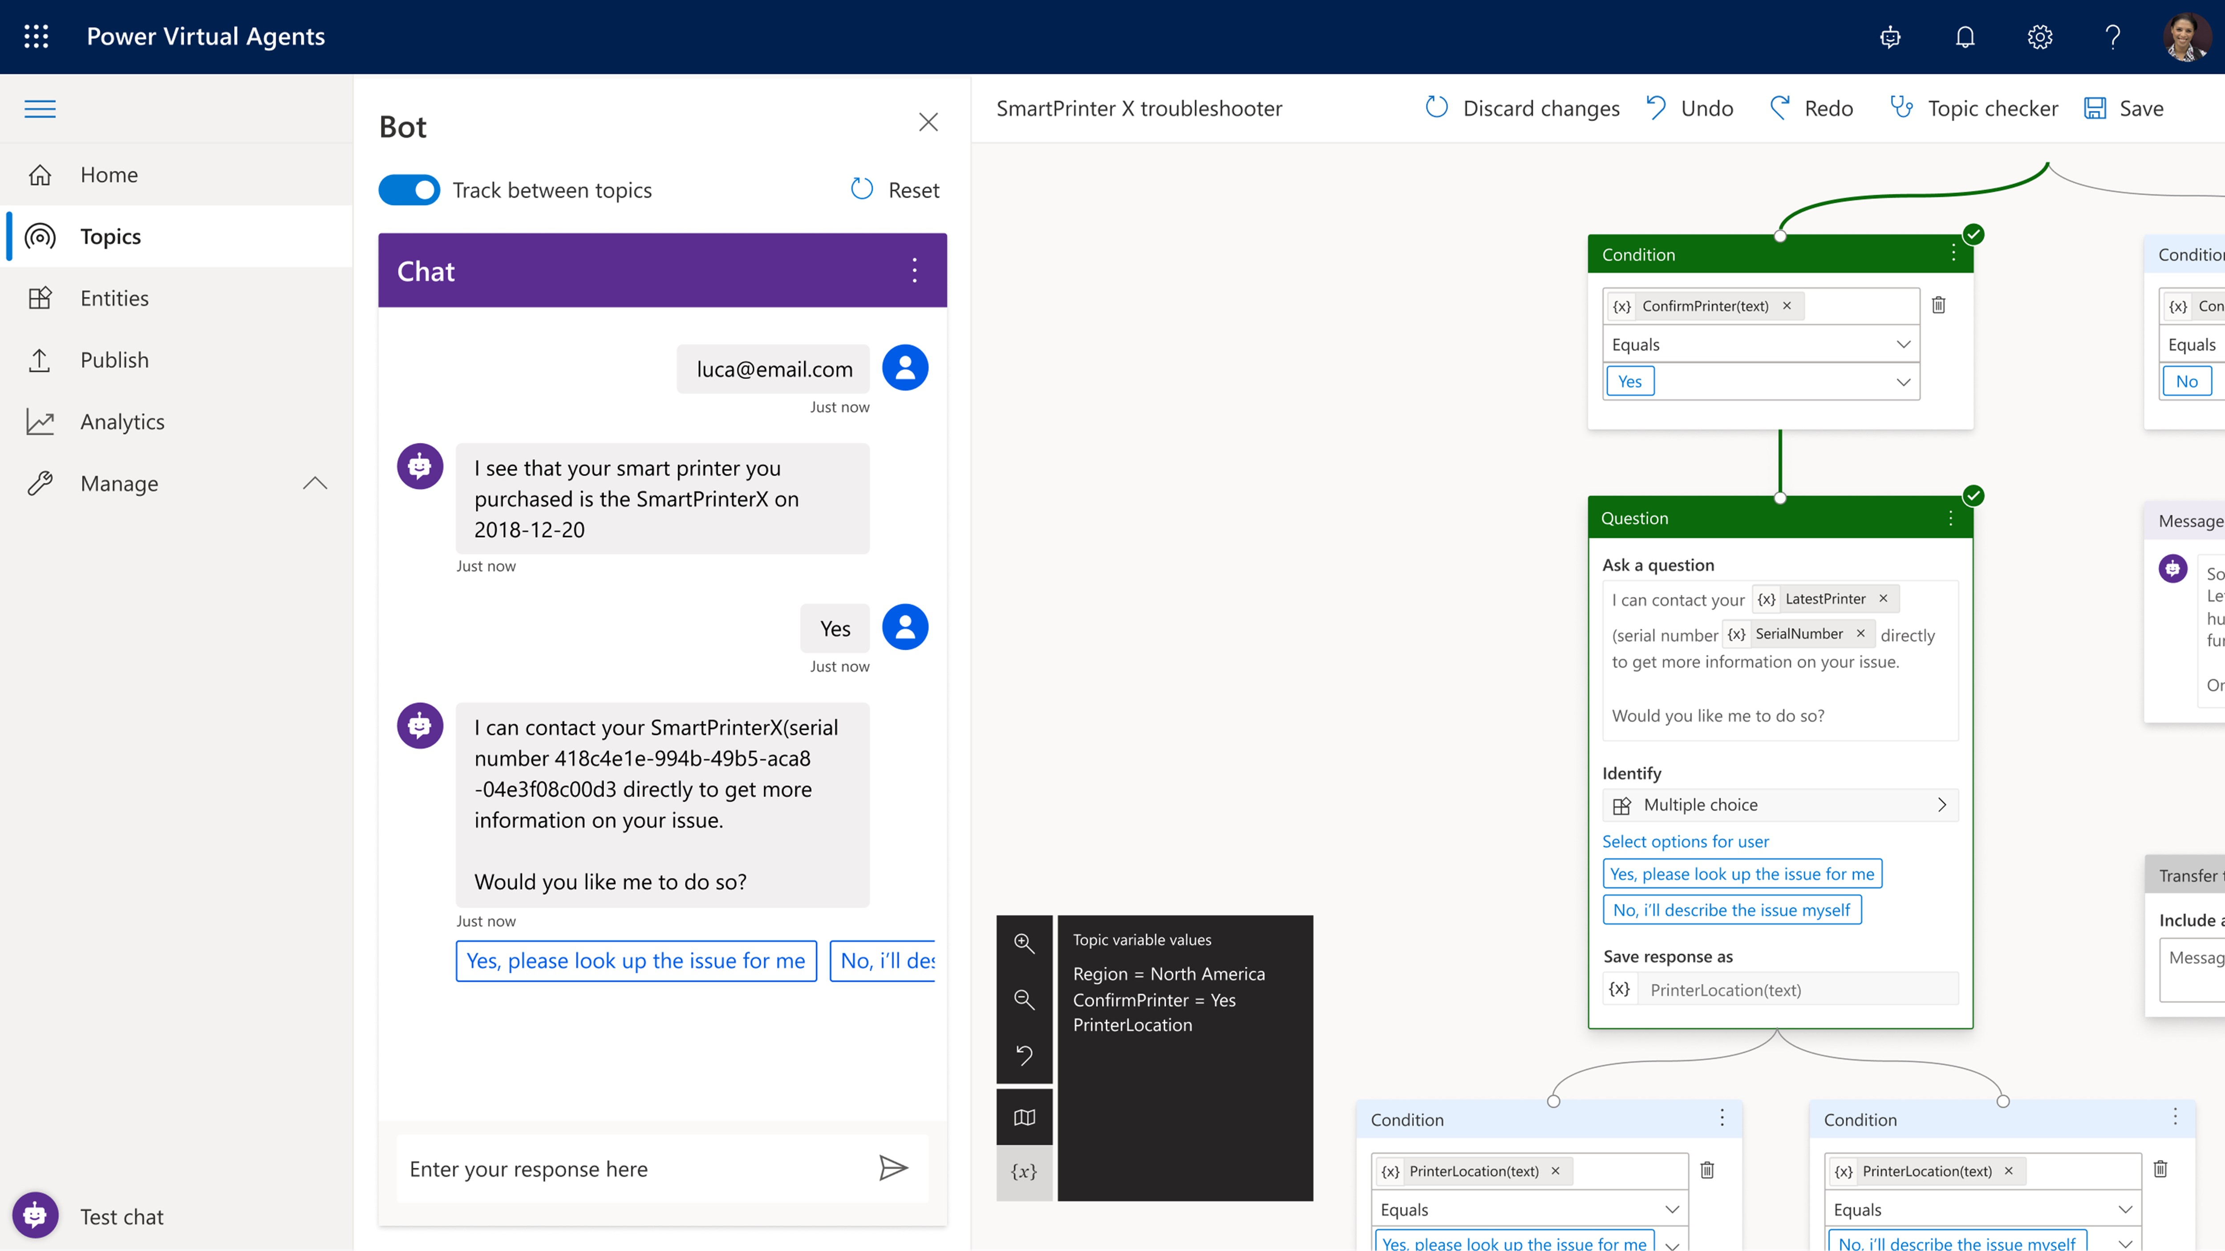
Build powerful virtual agents with Power Virtual Agents
Enable subject matter experts to easily create powerful virtual agents using a guided, no-code graphical interface—all without the need for data scientists or developers
Enable the virtual agent to take action on the customer’s behalf; Easily integrate your virtual agent with hundreds of services and systems out of the box or create custom workflows
Keep an eye on how your virtual agent is performing by using conversational metrics and dashboards; Get in-depth AI-driven insights to improve bot performance
Notes:
Looking more deeply at this on our final day together.

Slide 9
Pulling it all together
Power Platform helps to add value to any business by analyzing, acting, and automating
Build custom apps in Power Apps
Automate processes with Power Automate
Analyze data with Power BI

Slide 10
Power Apps

Slide 11
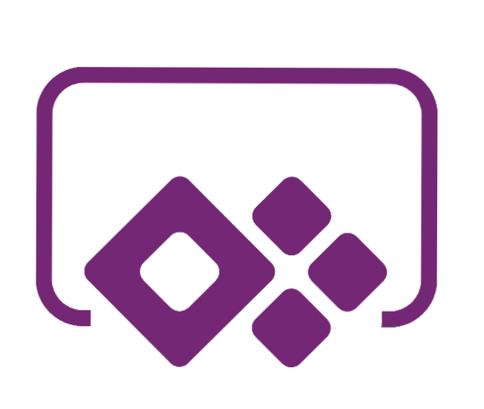
What are power apps?
Applications that anyone can build for the web and mobile devices— No coding experience.
A drag and drop interface allows you to add and configure what you need to solve the problem at hand with controls like buttons and galleries.
An Excel-like formula bar allows you to dig in a little deeper and apply more complex rules and logic. See results in real time.
You can extend Power Apps by creating customized connections and building blocks that can be used across multiple programs
Notes:
Developing apps is sometime seen as complex, costly or time consuming or if you are like me, its something that I didn’t think I had the skills set to do and really I haven’t ever had much interesting in coding.
But using this approach know as low code development, anyone can create apps for web and mobile devices without traditional coding skills.
Its simple enough for beginners and you can actually get really sophisticated for those who do work professionally as a developer in an organization that is maybe an enterprise or a start up.
There is functionality that you may be familiar with like drag and drop and there is an excel like formula bar where you can make changes and see them in real time
In any scenario, power apps reduce the amount the work involved in getting an app up and running for any of us.
With a simple interface you can create apps that digitze paper processes, collect and share data or just streamline. Without learning to code (or have a degree in Computer science)
Only end to end low code solution - Power BI, Flow and PowerApps on one platform (CDS). No other vendor has that.
Running on our own cloud.

Slide 12
Comparing the three powerapp types
Purpose
Type
When to use
You need users to submit PTO requests through an app displayed in Teams
Custom Design
Canvas App
Your administrative HR team will review the PTO requests and approve or deny them
Model Driven App
More data controlled
Business Processes such as Sales, Customer Service, or Marketing
D365 App
Your Marketing team needs to create segments and design beautiful email templates to market for events
Notes:
There are two kinds of PowerApps, if we don’t count Dynamics apps. While both are built on the CDS, the main difference between the two is designer control.
Canvas App give you full control over every single aspect of the result. Using excel-like expressions and drag and drop, you can build out elements into the canvas form for whatever you require. Additionally, with Model Driven Form Integrations, you can display a canvas app inside a dynamics app to fulfill a specific purpose that can’t be done as easily in a Model Driven design. Canvas apps look and feel more like your typical “app.”
This is for more of a business logic. Model apps can run either as standalone or as the backend to a canvas app. No matter the source, though, the app will look about the same in structure. You can customize the entity (forms, fields, etc), but the structure will be about the same.
There are also dynamics apps, which we’ll look at tomorrow. These are, if I boil it down, essentially pre-designed (and complicated!) Model Driven apps. Not the best description, but I need to keep moving!

Slide 13
Demo
Notes:
Navigating Make.Powerapps.Com
Create a Model Driven App
Create a Canvas App
Explore customizing Model Driven and Canvas Apps

Slide 14
Discussion Point
Can you create a Canvas App and explain why you would use it vs. a Model Driven App?
What is the difference between a tenant and an environment? Which can have multiple of which?
Can you navigate to the account entity and locate the primary field?

Slide 15
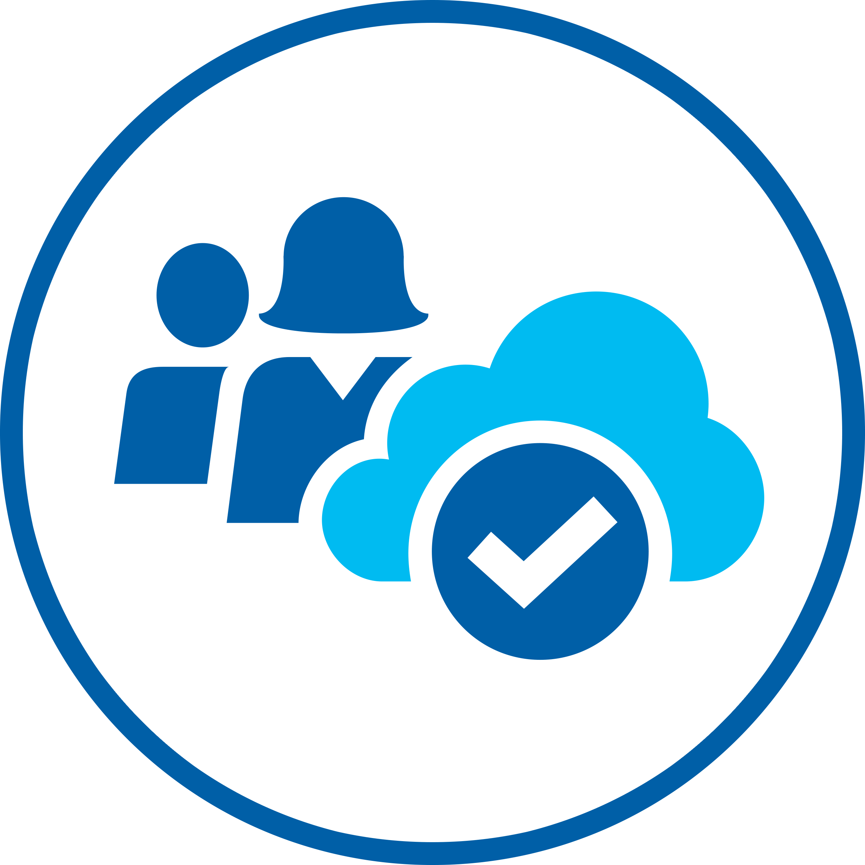
Whiteboard Design Session

Slide 16
Long Break
Please return to the session by 12:00pm PT

Slide 17
Team Challenge
Delivering a collaborative Microsoft 365 environment that includes power platform and D365 integrations.

Slide 18
Office Hours

